Slide 1
INFSCI 2500 Lecture 4 Array Lists

Slide 2
Today’s Plan
Understand methods in the List interface
Understand how to use an ArrayList
Look under the hood of ArrayList class
Understand how an ArrayList is useful
Build the VeryLongInt class

Slide 3
Questions on HW2

Slide 4
List Interface
Extends the Collection interface
Support for indexes
All lists store things in sequence
Methods all utilize indexes as parameters or return types

Slide 5
List Interface
E get(int index)
E set(int index, E element)
int indexOf(Object element)
void add(int index, E element)
E remove(int index)

Slide 6
List Interface
E get(int index)
E set(int index, E element)
int indexOf(Object element)
void add(int index, E element)
E remove(int index)

Slide 7
ArrayList Class
Improved one-dimensional array
Supports random access
Size maintained automatically
insert and delete handled automatically

Slide 8
ArrayList Class
Sequential
Parameterized
ArrayList<E>
ArrayList<String> myList = new ArrayList<String>();
No primitives
Wrappers allowed

Slide 9
ArrayList Method Examples
Constructors
public ArrayList(int initialCapacity)
public ArrayList()
ArrayList<String> xyz = new ArrayList(100);
//100 spots
ArrayList<String> xyz = new ArrayList();
//10 spots

Slide 10
ArrayList Method Examples
Similar to an array
String[] xyz = new String[100];
Dissimilar to an array
String[] xyz = {“x”,”y”,”z”};

Slide 11
ArrayList Method Examples
Copy Constructor
public ArrayList(Collection<? extends E> c)
ArrayList<String> myList = new ArrayList<String>();
myList.add(“x”);
myList.add(“y”);
myList.add(“z”);
ArrayList<String> myList2 = new ArrayList<String>(myList);
Size is 110% of original ArrayList

Slide 12
ArrayList Method Examples
Copy Constructor
public ArrayList(Collection<? extends E> c)
The parameter c can be any class implementing Collection
<? extends E> means element type of collection to be copied must be same or subclass of ArrayList element type

Slide 13
ArrayList Method Examples
Copy Constructor
public ArrayList(Collection<? extends E> c)
New ArrayList contains copies of references, not elements.
Shallow copy
Similar to System.arraycopy
Operates in O(n) time

Slide 14
ArrayList Method Examples
public boolean add(E element) //O(n)
Always returns true
dictated by implementing the Collection interface
other classes might return false (duplicates)
ArrayList<String> myList = new ArrayList<String>();
myList.add(“x”);
myList.add(“y”);
myList.add(“z”);

Slide 15
ArrayList Method Examples
public boolean add(E element) //O(n)
Dissimilar to an array
no index required
String[] xyz = new String[10];
xyz[0]=“x”;

Slide 16
ArrayList Method Examples
public int size()
ArrayList<String> myList = new ArrayList<String>();
myList.add(“x”);
myList.add(“y”);
myList.add(“z”);
int i = myList.size(); //3

Slide 17
ArrayList Method Examples
public int size()
Dissimilar to an array
size gives number of elements or occupied spots
array.length gives total numer of spots

Slide 18
ArrayList Method Examples
public E get (int index)
myList.get(2); //”z”
Similar to an array
myArray[2]
Dissimilar to an array
myArray[2]=“a” //Legal
myList.get(2) = “a” //illegal

Slide 19
ArrayList Method Examples
public E set(int index, E element)
myList.add(“x”);
myList.add(“y”);
myList.add(“z”);
myList.set(2,”x”);
//replaces “z” with “x”, returns “z”
Similar to an array
array[2]=“x”;

Slide 20
ArrayList Method Examples
public void add(int index, E element)
inserts the element and pushes other elements down the line
myList.add(“x”);
myList.add(“y”);
myList.add(“z”);
myList.add(1,”a”);
//”x”,”a”,”y”,”z”

Slide 21
ArrayList Method Examples
public void add(int index, E element)
Dissimilar to an array
Expansion and rearrangement handled automatically

Slide 22
ArrayList Method Examples
public E remove(int index)
myList.add(“x”);
myList.add(“y”);
myList.add(“z”);
myList.remove(1);
//”x”,”z” returns”y”

Slide 23
ArrayList Method Examples
public E remove(int index)
Dissimilar to an array
Automatically handles rearrangement
No contraction

Slide 24
ArrayList Method Examples
public int indexOf(Object element)
finds first occurrence of matching element
myList.add(“x”);
myList.add(“y”);
myList.add(“z”);
int x=myList.indexOf(“z”); //x=2
int x=myList.indexOf(“a”); //x=-1

Slide 25
ArrayList Method Examples
public int indexOf(Object element)
finds first occurrence of matching element
Dissimilar to an array
No need to explicitly search

Slide 26
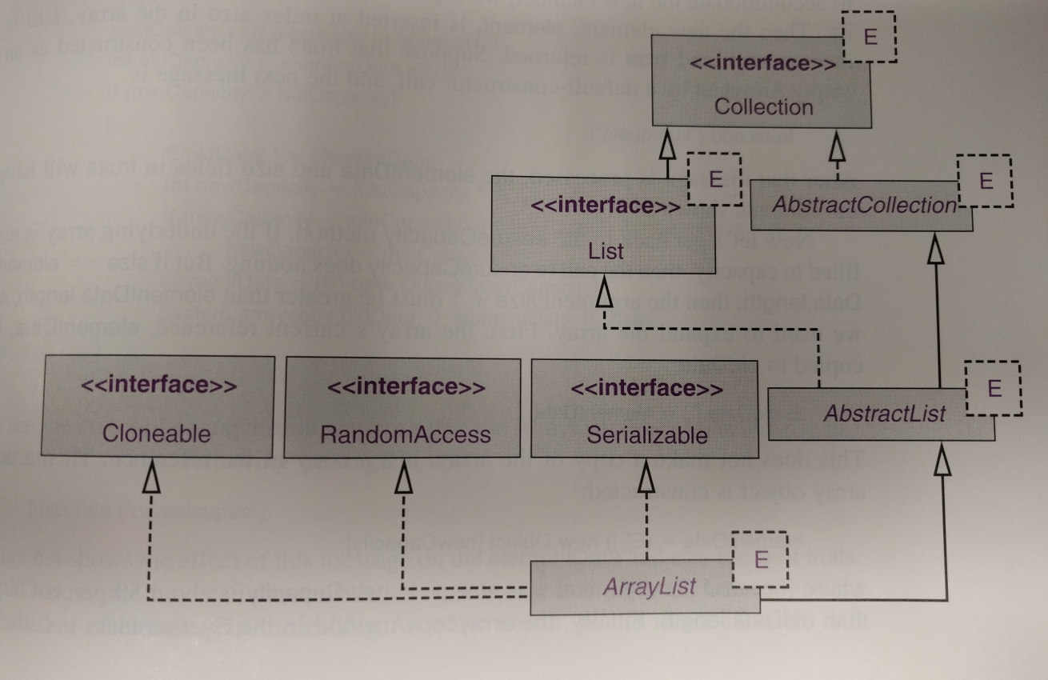
ArrayList Heading And Fields
public class ArrayList<E> extends AbstractList<E> implements List<E>, RandomAccess, Clonable, java.io.Serializable

Slide 27
ArrayList Heading And Fields
private transient E[] elementData;
array not preserved in serialization
private int size;
Users never touch these!

Slide 28
ArrayList Usage
ALExample.java

Slide 29
Exercise 1
ArrayList<Character> letters = new ArrayList<Character>();
letters.add(‘f’);
letters.add(1,’i’);
letters.add(‘e’);
letters.add(1,’r’);
letters.add(‘e’);
letters.add(4,’z’);
System.out.println(letters);

Slide 30
Exercise 2
letters.remove((Character)‘i’);
int index = letters.indexOf(‘e’);
letters.remove(index);
letters.add(2,’o’);
System.out.println(letters);

Slide 31
Exercise 3
ArrayList<String> list = new ArrayList()<String>;
list.add(“ONE”); list.add(“FOUR”); list.add(2,”THREE”); list.add(2,”TWO”); list.add(2,”FIVE”);
System.out.println(list);

Slide 32
Exercise 4
ArrayList<String> names = new ArrayList<String>();
names.add("Karen");
names.add("Don");
names.add("Mark");
ArrayList<String> temp = new ArrayList<String> (names);
ArrayList<String> sameList = names;
names.add(1,"Courtney");
System.out.println("names: "+names);
System.out.println("temp: "+temp);
System.out.println("sameList: "+sameList);

Slide 33
add Method Detail
public boolean add(E element){
ensureCapacity(size+1);
elementData[size++]=element;
//inserted at size, then incremented
return true;
}

Slide 34
add Method Detail
public void ensureCapacity(int minCapacity){
modCount++;
int oldCapacity=elementData.length;
if(minCapacity > oldCapacity){
E oldData[]=elementData;
int newCapacity=(oldCapacity*3)/2 +1
if(newCapacity<minCapacity){
newCapacity=minCapacity;
}
elementData = (E[]) new Object[newCapacity];
System.arraycopy(oldData,0,elementData,0,size);
}
}

Slide 35
add Method Detail
board example

Slide 36
Build ArrayListDemo
ArrayListDemo.java

Slide 37
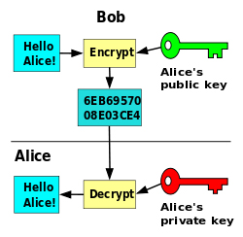
High Precision Arithmetic
Application of ArrayList class
Public key cryptography
Keys are composed of large prime numbers
100 digits or more
Creating a number is easy O(n³)
Factoring a number is
HARD O(10^{n/2})

Slide 38
High Precision Arithmetic
Generate p and q, two large primes
Generate e, greater than p * q
Public key is p*q (modulous) and e (exponent).
Private key is p and q
Treat the message with public key to send it
Plaintext -> ciphertext
Treat the message with private key to read it
-ciphertext -> plaintext

Slide 39
High Precision Arithmetic
The message M is split into characters M₁…M_{i}
M sequence is turned into V sequence by concatenation of bits
Very long integer
Encrypted integer V_{i} = V_{i}^{e} % (p*q)
Raise V_{i} to e, then mod (p*q)
This requires precision beyond built-in functionality

Slide 40
VeryLongInt Class Methods
Create from a String
public VeryLongInt(String s)
Turn into a String
public String toString()
Add to another VeryLongInt (addition, not ‘adding’)
public void add(VeryLongInt otherVeryLong)

Slide 41
VeryLongInt Class Fields
Has-a or is-a?
VeryLongInt performs addition
dissimilar to ArrayList function
Use ArrayLists, not extend it
protected ArrayList<Integer> digits;

Slide 42
VeryLongInt Implementation
VeryLongInt.java

Slide 43
Conclusion
List interface extends Collection interface
Index based methods
ArrayList implements List
Allows random access
Automatically resizable
Much easier to utilize

